Slide 1


Sustainable inks: Understanding the Environmental aspects
Dr. Vroni Walter
Head of Innovation and Technology - Epple Druckfarben AG

Slide 2
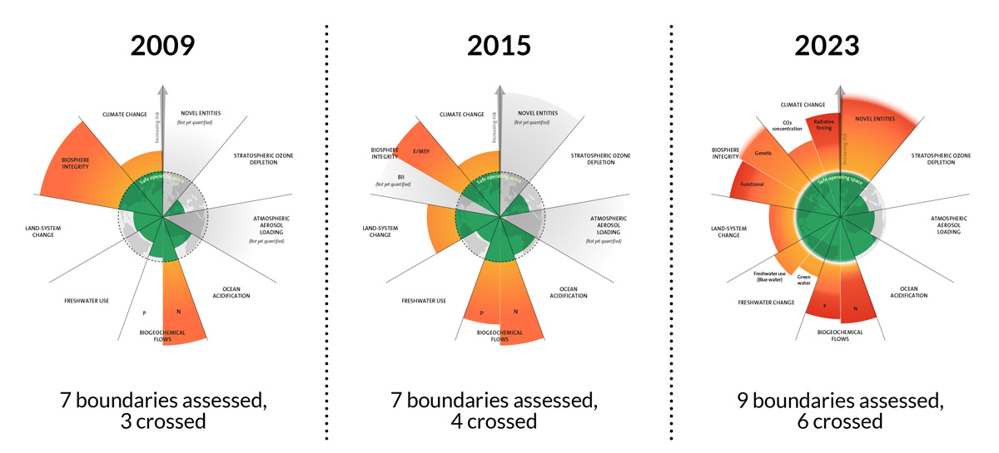
Sustainability is no absolute term but has always to be considered in various impact categories
https://www.bmuv.de/themen/nachhaltigkeit/integriertes-umweltprogramm-2030/planetare-belastbarkeitsgrenzen Based on Richardson et al. 2023, Steffen et al. 2015, and Rockström et al. 2009.

Slide 3

Life Cycle Assessment (LCA) is a systematic approach over all the stages of the product life cycle
by addition and evaluation of different impact factor over the life cycle
high-quality data from all phases are required, transparent communication and close cooperation over the supply chain is crucial
to make a general assessment of sustainability possible (e. g. “VdL position on the initiative for sustainable products”, 16.11.2020)
direct comparability between different studies and methods is difficult or impossible
.

Slide 4

Cradle-to-grave Cradle-to-gate
3. Transport
3. Transport
>
>
>
>
>
4. Product Use Phase
2. Product manufacturing
>
4. Product Use Phase
2. Product manufacturing
LCA
LCA
>
>
>
>
5. End of Life
5. End of Life
1. Raw Material manufacturing
1. Raw Material manufacturing
Must cover the full life cycle of a product
Printing inks are not manufactured for direct use by end customer
Product use phase & end of life are mainly unknown for printing ink manufacturer
Focussing only on the steps in the life cycle related to the ink manufacturing (direct impact)
Enable customers to calculate their own product related environmental impact

Slide 5
Of all the impact categories, the carbon footprint is the most familiar in the general public
Product carbon footprint (PCF): the balance of greenhouse gas emissions along the entire life cycle of a product (defined application and defined unit of use)
Cradle-to-gate PCF: includes processes from the sourcing of raw materials and production
Cradle-to-grave PCF: covers the entire life cycle of the product, including emissions from the use phase and the end of life.
The PCF can be calculated using various methods, e.g., according to the greenhouse gas protocol product standard, EN ISO 14044 (LCA), or EN ISO 14067 (PCF). The absolute numbers of different manufacturers are therefore not generally comparable.
Since the absolute values ​​depend heavily on the selected system boundaries, reliability of the raw data and assumptions made in the calculation, a transparent communication of the method is essential.

Slide 6
Different emission scopes contribute for Product Carbon Footprint (PCF)
Scope 1
Scope 2
Scope 1
  Direct GHG emissions generated by a company
    e.g. emissions from company facilities, boiler house, company cars
Scope 2
  Indirect GHG emissions generated by a company
    e.g. purchased steam & electricity (converted into CO₂eq.)
Scope 3 (to be divided into up-stream and down-stream emissions
  Upstream: Indirect emissions (generated externally)
    e.g. emissions generated by the raw materials used
  Downstream: Indirect emissions (generated by use of the products)
    e.g. emissions generated by the printing process, end of life emissions
Scope 3
Typical share of emissions generated by the different scope for the chemical industry (TfS)
For the cradle-to-gate boundary only the Scope 3 upstream emissions need to be considered

Slide 7
Printing ink manufactures in the value chain
The position of a printing ink manufacturer in the value chain is directly impacting the contribution of an ink to the footprint of the final product.
Example: Value chain for packaging of filled goods
Packaging components (e.g., glue) production
Filling good production
Raw material production
Substrate production
Packaging printing
Packaging end production
Filling product in packaging
Selling product on the market
Use phase
customer
End of life
Additive production
Resin production
Printing ink producers are only a small piece of the long value chain
Only ~2% of the finished product PCF is the ink contribution
Position: Middle of first half of the value chain
Printing ink production
Pigment production
Solvent production

Slide 8
Roadmap to reduce the product carbon footprint
Make it a management priority
Calculate your own carbon footprint to understand the hotspots of your company
Reduce your own
Scope 1+2 emissions using clean energy or process optimization
Re-evaluate
Use alternative raw materials such as biobased, recycled or mass balanced

Slide 9

What should you look for?
.
Look for science based and general accepted guidelines.
Look for standards and approaches that are broadly considered to be industry best practices.
Look for industry standards and guidelines harmonized by associations.
Together for Sustainability Guidelines (TfS)
ISO14040, ISO14044 and ISO14067
Science Based Target Initiative (SBTI)
Ecovadis Score
Carbon Disclosure Project (CDP)
Greenhouse Gas Protocol (GHG)

Slide 10
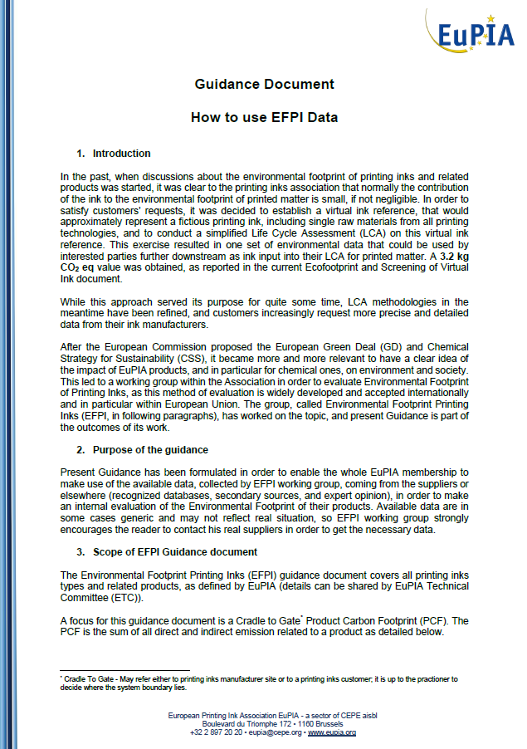
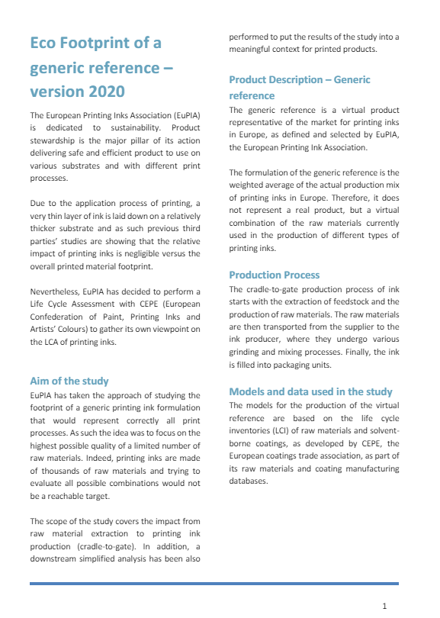
European Printing Ink Association (EuPIA) internal guidance and strudy on generic reference
.
The Environmental Footprint Printing Inks (EFPI) guidance document has been formulated in order to enable the whole EuPIA membership to make use of the available data coming from the suppliers or elsewhere (recognized databases, secondary sources, and expert opinion), in order to make an internal evaluation of the Environmental Footprint of their products
This guidance covers all printing inks types and related products, as defined by EuPIA, and focuses on the Cradle-to-Gate Product Carbon Footprint (PCF)
Eco Footprint screening study was performed on a generic ink formulation for high-level assessment

Slide 11
Wider considerations – Working downstream to reduce emissions
.
It is important to understand the various impacts of the different steps in your supply chain and manufacturing process.
By understanding the hotspots of your own process, you can create specific actions or implement changes that results in greater reductions.
For a typical ink (~ 2% of total emissions in final printed product), raw materials (approx. 85%) and manufacturing (approx. 15%) are the two highest contributing factors to focus on, if you want to reduce your emissions.
Ink manufacturers are working to reduce the carbon footprint of their products. We take a holistic approach to reducing environmental impact.
Ink manufacturers are working with raw material suppliers to reduce these emissions. As we work with supplier, we are trying to understand the wider environmental impacts of alternative products such as impacts on biodiversity and land use change.
We also want to work with customers to take an LCA approach – to understand the downstream impact
  How much energy is used in printing and drying inks?
  How can ink facilitate and contribute to the recover of packaging substrates?
We must work collaboratively to address these shared objectives.

