Slide 1

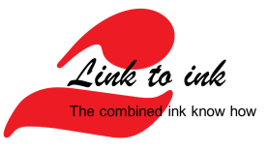
Fit for recycling – How inks enable a Circular Economy
German Paint and Printing Ink Associations
Represented by Ewald Rempel (Sun Chemical) & Alina Marm (Siegwerk)

Slide 2
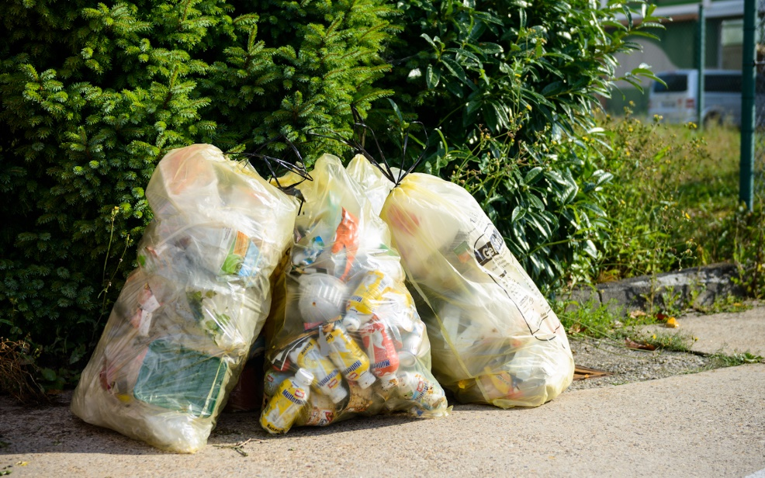
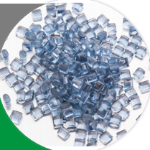
What we want….
Recycling of plastic waste with the least loss of material value → high quality recyclates
Foto credits: Siegwerk, https://www.awg-info.de/privatkunden/gelber-sack

Slide 3
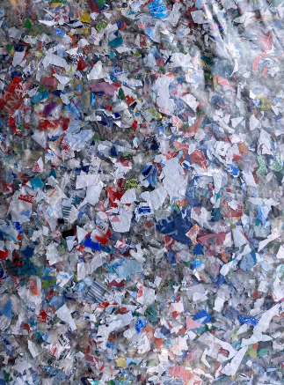
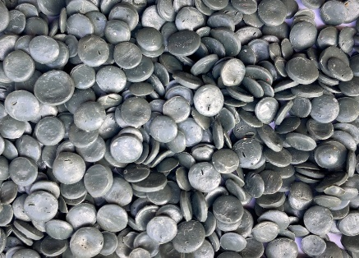
What we get…
Recyclates that are not fit for broad use
Sorted input stream PCW
PCR
Quality impairment of PCR¹
Caused by contaminants like food residues, adhesives, barrier materials, inks, etc.
Odor
Gel particles, black spots
Mechanical properties
Discoloration
Color fluctuations
Washing
Extrusion > 200°C
Optical uniformity
Haze
1. Qualitative assessment, depending on the target application
Source: Recycling of flexible packaging - heat stable inks and deinking I Dec 2022
Notes:
Props: shredded & extruded pellets, blown film (non-de-inked)

Slide 4
Circular Economy and Recycling – a fast moving topic
Today’s recycling techniques and packaging materials are not fit for the ambitious recycling goals on global, EU and national level Scientific background is often lacking (but improving)
Huber – check source
How to get there?
Understand behaviour of today’s packaging structure on today’s recycling practices and improve it (Design for recycling – D4R)
EU Plastic packaging recycling rates/targets
2016 | 2021 | 2025 | 2030
42% | 40% | 50% | 55%
By 2030 all plastic packaging should be recyclable!
Innovate recycling techniques to improve recyclate quality. (Collecting/ Sorting/Deinking)
Innovate inks and other packaging materials to support today’s recycling techniques

Slide 5
Let us explore how inks can contribute to the CE and recycling ambitions
The Life Circle Assessment perspective of inks in packaging
Supporting the move to monomaterials
Quo Vadis Nitrocellulose?
De-inking for high quality recyclate
Driving forces of a circular economy

Slide 6
Circular Economy
Life Cycle Assessment

Slide 7
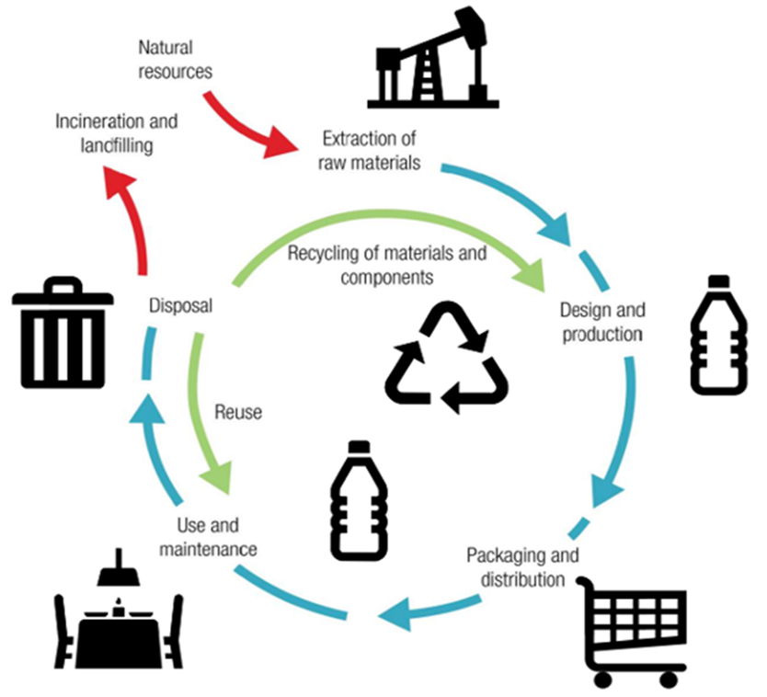
What is Life Cycle Assessment?
  Life Cycle Assessment (LCA) is a systematic method for evaluating the environmental impacts of a product, process, or activity throughout its entire life cycle
  LCA considers various environmental aspects, such as resource depletion, energy consumption, greenhouse gas emissions, and other pollutants
  LCA helps identify areas where improvements can be made to minimize environmental harm and optimize sustainability - but is often lacking (but improving)

Slide 8
Life Cycle Assessment (LCA) vs. Product specific assessment
Two different options to determine the environmental impact of a product
Life Cycle Assessment (LCA)
Product specific assessment
3. Transport
3. Transport
2. Product manufacturing
4. Product Use Phase
2. Product manufacturing
4. Product Use Phase
1. Raw Material manufacturing
5. End of Life
1. Raw Material manufacturing
5. End of Life
Must cover the full life cycle of a product
Printing inks are not manufactured for direct use by end customer
Product use phase & end of life are mainly unknown for printing ink manufacturer
Focussing only on the steps in the life cycle related to the ink manufacturing (direct impact)
Enable customers to calculate their own product related environmental impact
“Cradle-to-gate” approach
Notes:
Purpose
Emphasize the difference on LCA and how cradle-to-gate is just a fraction of the full life cycle. Why cradle-to-gate etc.?

Slide 9









Cradle-to-gate approach
In Scope
Raw Material Production
Ink manufacturer’s Gate
Customer Gate
Use phase
End of Life
Cradle-to-grave
Cradle-to-gate
Enables the printing ink manufacturer to control the environmental impact of stages in its own hand
  Raw material supply (supplier firsthand data retrieval possible)
  Own manufacturing process
Enables customer to calculate their own environmental impact
No double counting along the value chain
Reflecting the ink manufacturing impact in the best possible way
Notes:
Purpose:
Explain difference boundaries, explain why we have these systems.
Notes:
Key point; avoid double counting, check your boundaries:
Quickly explain the term “cradle” “end of life” etc.

Slide 10
Printing Ink manufactures in the value chain
The position of a printing ink manufacturer in the value chain is directly impacting the contribution of an ink to the footprint of the final product
Example: Value chain for packaging of filled goods
Raw material production
Packaging components (e.g., glue) production
Filling good production
Additive production
Substrate production
Packaging printing
Packaging end production
Filling product in packaging
Selling product on the market
Use phase
end-customer
End of life
Resin production
Printing Ink production
Pigment production
Solvent production
Printing ink producers are only a small piece of the long value chain
Only ~2% of the finished product carbon footprint is the ink contribution
Position: Middle of first half of the value chain
Notes:
Purpose:
Explain value chain and how our position influences our ability to do calculations.

Slide 11
Circular Economy
Supporting the move to mono-materials

Slide 12
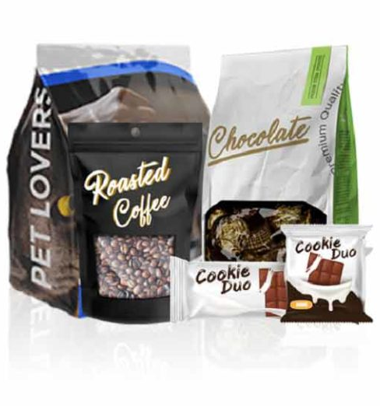
Why use Flexible Packaging structures?
Price competitiveness
Eye-Catcher - presentation of the product - advertisement
Less weight and waste volume compared to glass or metal containers
Barrier functions protecting the product
light, moisture, oxygen, microbial activity, taste & smell, evaporation, physical containment

Slide 13

Complexity of packaging structures versus recycling
Multimaterial packaging has lately become under pressure due to the combination of various materials with different properties like polymers, aluminum and inorganic barrier coatings
Multimaterial packaging is therefore difficult to recycle in existing waste management infrastructures without a de-lamination step before de-inking and granulation
A reduction of material complexity would most likely cause a shorter shelf-life, especially of food products
The trend points towards monomaterial structures based on Polyolefin substrates in combination with suitable barrier coatings like SiOx and AlOx which are fully compatible in the recycling stream

Slide 14


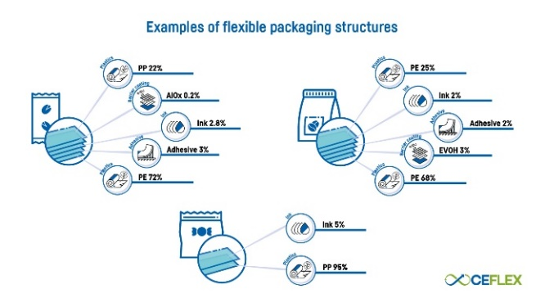
Typical Flexible Packaging Components
Monomaterials
Organic coating
Ceramic coating
Polyolefins (PE & PP)
Polyester (PET)
Polyamide (PA)
Acrylics
EVOH
PVdC
Silicon Oxide (SiOx)
Aluminium Oxide (AlOx)
Metallization
Multilayers
Thin layer coating of metallic aluminum
Combination of various monomaterials and barrier coatings

Slide 15
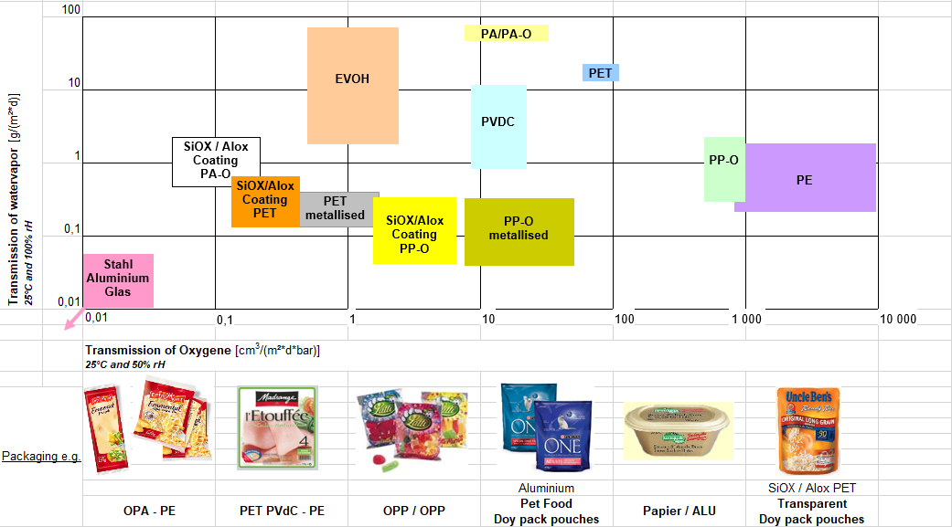
Barrier Properties of Packaging structures

Slide 16
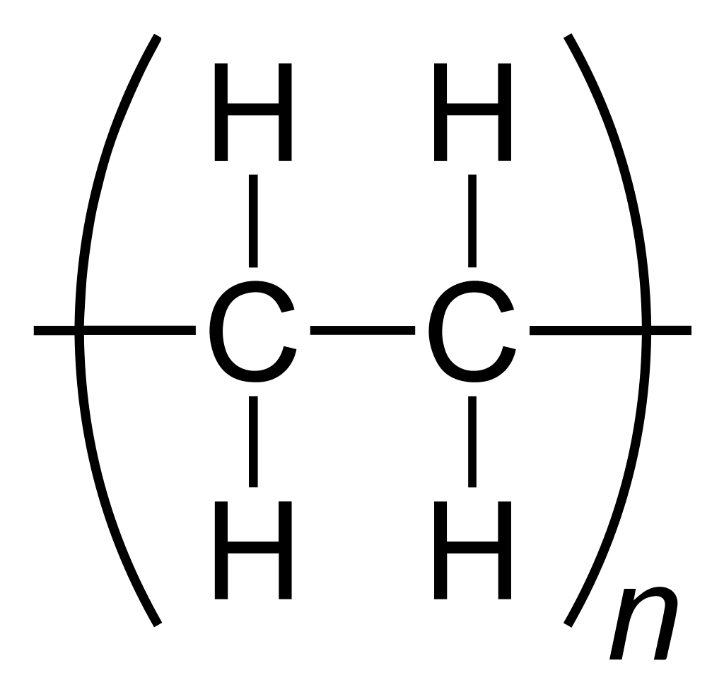

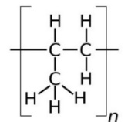
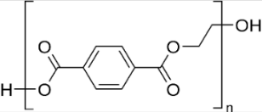
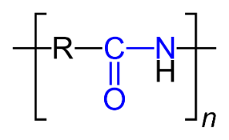
Monomaterials
Typical substrates: PE, PP, PET and PA
Advantages
Disadvantages
Easy to recycle (after de-inking)
No need for de-lamination
Good moisture
barrier
Flexible
Poor gas barrier though properties are increasing with polymer density PE → PA
PET and PA not compatible with Polyolefin recycling stream

Slide 17

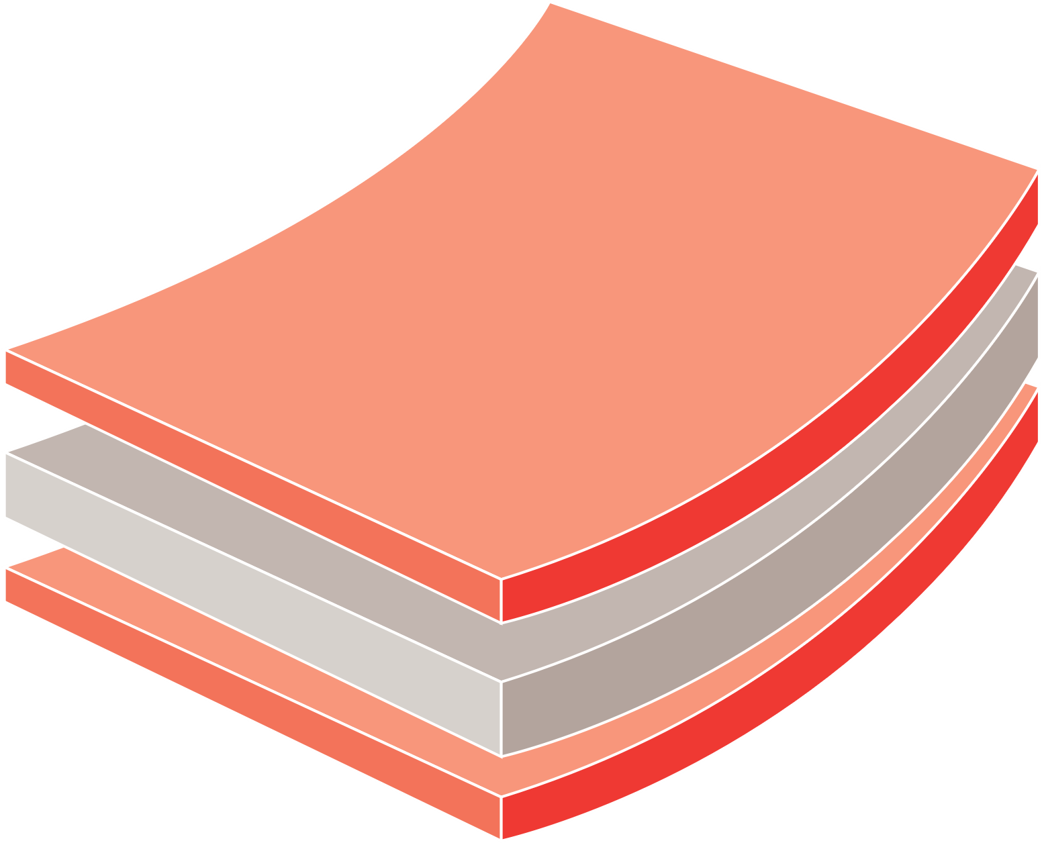
Coated Polyolefins
Typical substrates: BoPP coated with Acrylic, EVOH or PVdC
Advantages
Disadvantages
Very high moisture barrier
Very high O2 barrier
Good aroma barrier
Crack
resistant
Problematic for recycling – reduces quality of the recyclate (yellowing)
PVdC may release carcinogenic dioxines when heated during extrusion of recyclate
Acrylic coated layer
Transparent OPP core layer
Acrylic coated layer
Enhanced Low Seal PVdC Coating
Oriented Polypropylene
Enhanced Low Seal PVdC Coating

Slide 18
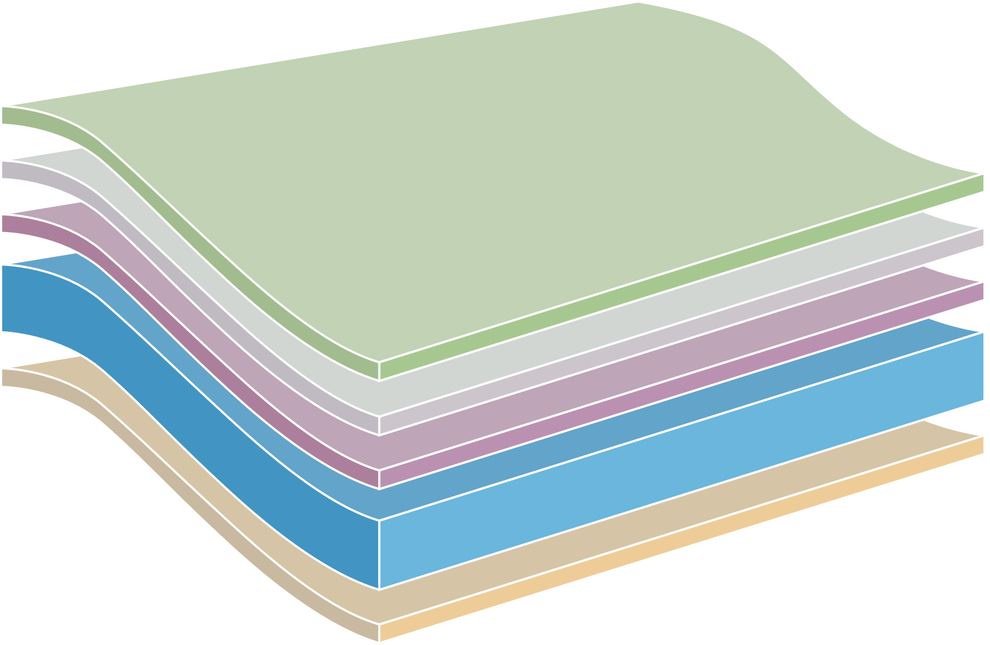
Ceramic coating
Typical substrates: PET, BoPP, PA
Advantages
Disadvantages
Generally, very high all-round barrier properties
Fully compatible in recycling stream
Not detected by
metal detectors
Suitable for
microwave
Not crack resistant (glass like) – potential loss of barrier properties
AlOx can be challenging to overprint
SiOx can be difficult to laminate
Cost
Protect Layer
AlOx Coating
Corona Treatment
PET Core Layer
Plain Surface

Slide 19
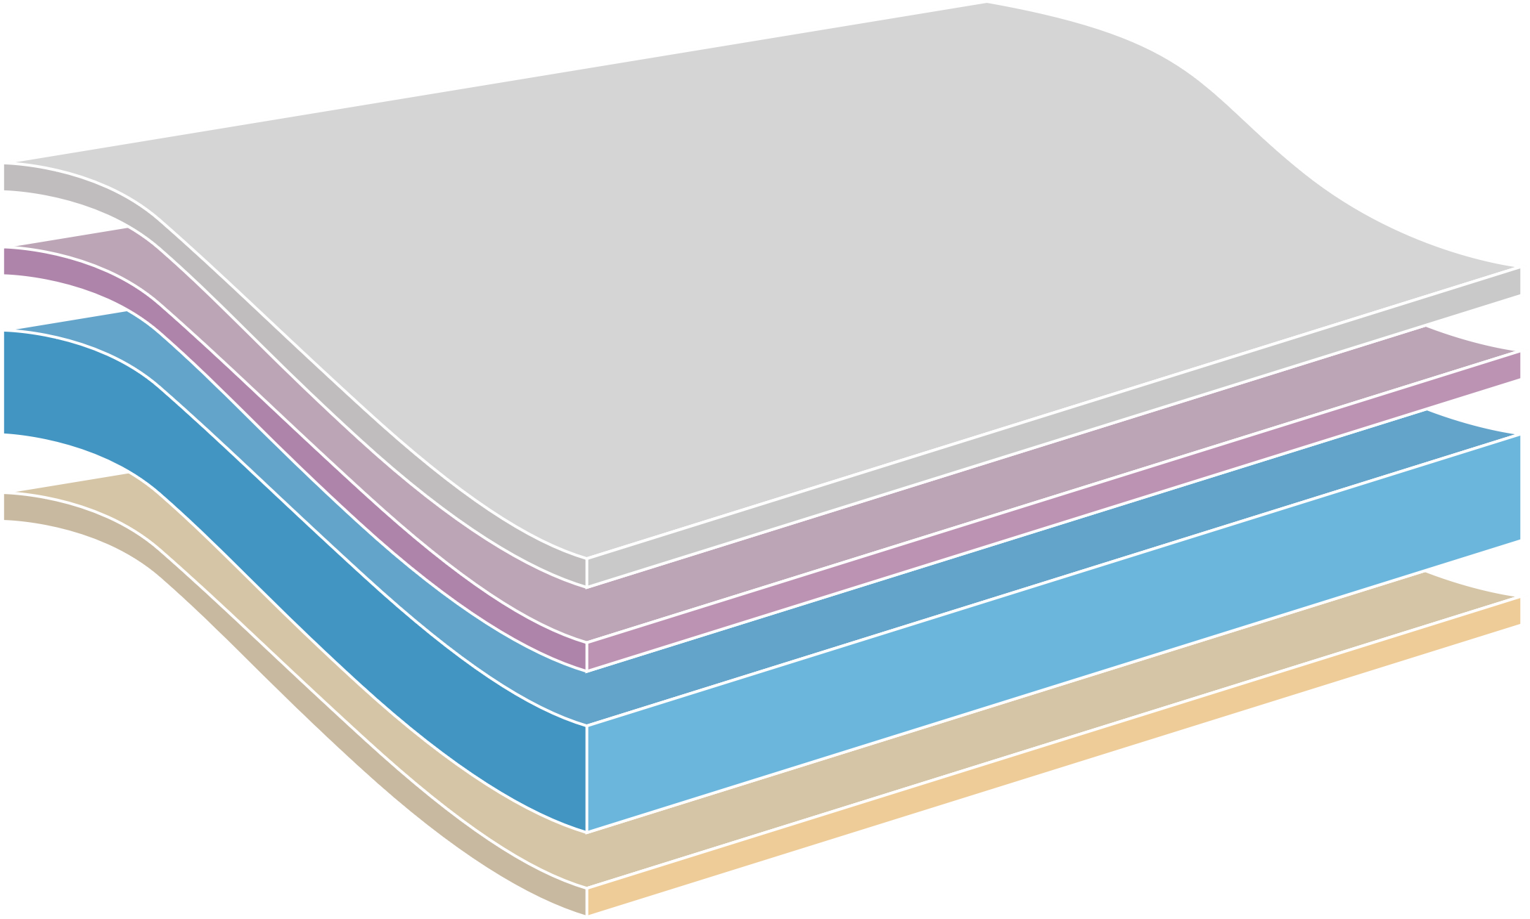
Metallization
Typical substrates: PET, BoPP
Advantages
Disadvantages
Generally, very high all-round barrier properties
Light barrier
Improved optical
aspects
Not separable during recycling causing discolouration of recyclate
Detected by metal detectors
Not suitable for microwave
Metalized Layer
Corona Treatment
BOPP Core Layer
Heat-Sealing Layer

Slide 20
Multilayers
Typical substrates: Combination of different materials and barrier coatings
Advantages
Disadvantages
Generally, very high all-round barrier properties
Tailored design for very specific needs
Protection of
barrier coatings
Not fully recyclable without prior de-lamination into monomaterials
Need for de-lamination
primer
Printing ink
Multilayer Flexible Packaging
Outer
Printed
Structural
Adhesive
Barrier
Adhesive
Inner/Seal

Slide 21


Quo Vadis Nitrocellulose?
NEXT STEP
FUTURE
Practical solutions
in a changing market environment

Slide 22
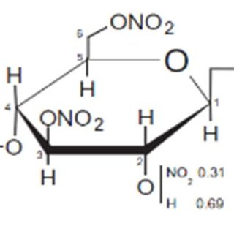
What is nitrocellulose?
Nitrocellulose (NC) is a common binder system used in solvent-based printing inks and varnishes for Flexible Packaging to a very large extend
In flexo and gravure printing this technology covers approximately more than 80% of the entire market for solvent-based inks in Europe
X
Y
n
X + Y =1

Slide 23
Printing inks for Flexible Packaging
Typical binder systems and their properties – pros and cons
Binder
NC, NC/PU
PVB
PVC
PU
Gravure printability
J
J
J
J
Binders account for around 10-20% of a solvent-based ink
NC is a very versatile binder system with many pros but also a very strong con ...
Flexo printability
J
K
L
J
Pasteurisation
K
J
J
J
Sterilisation
L
J
J
J
Range of substrates (adhesion)
universal
universal
universal
very universal
Printing speed
very high
high
very high
very high
Surface printing
J
L
L
L
Lamination High Perfromance
L
J
J
J
Lamination Medium perfromence
J
J
J
J
Lamination Standard Performance
J
J
J
J
Mechanical recycling
L
J
L
J
NC = nitrocellulose PU = polyurethane PVC = polyvinlyl chloride PVB = polyvinyl butyral

Slide 24
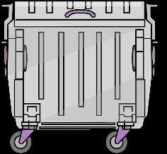
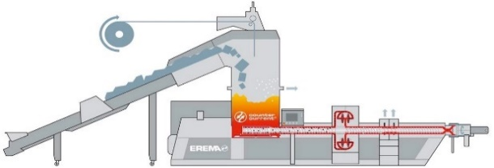
The future of NC inks
Physical Recycling
Printed Film
Polymers
Volatiles,
filter residue
Physical Recycling
Sorting and
Cold washing
Mechanical re-
cycling (thermal
process)
Physical recycling is a thermal process
that leads to thermal decomposition of temperature sensitive nitrocellulose
Regranulation 240 – 250°C

Slide 25
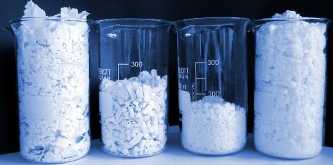
The future of NC inks
Current ink binders flexible packaging
Upcoming / new regulations
Flexo printing:
90% Nitrocellulose (NC)
Gravure printing:
75% NC
25% PVB, PVC and PU for high temperature (sterilization 120–130°C) applications
German “Minimum Standard”
Large format PE laminates printed with NC are not compatible with German recycling system;
but: no legal or financial consequences
Packaging & Packaging Waste Regulation (EU)
By 2030 all packaging must be recyclable –
non-recyclable packaging will be banned
Criteria will be defined (“delegated acts”)
Design for recycling (D4R) criteria by European Standard (CEN Institute)
Anticipated for 2027
Ceflex and RecyClass
D4R guideline amendment expected for Q4 2023/ Q1 2024 based on ongoing scientific evaluations
vs
Check and rephrase

Slide 26

The future of NC inks
Conclusion
We will get some kind of specific D4R criteria for inks (‘Mindeststandard’, RecyClass, Ceflex, CEN, PPWR) in the future
Criteria and details to need to be defined
Good news: There are potential alternatives available
Alternative binders (PU, PVB)
Modified mechanical recycling process: Deinking instead of “only” cold-washing

Slide 27
De-inking for creating high quality recyclates

Slide 28
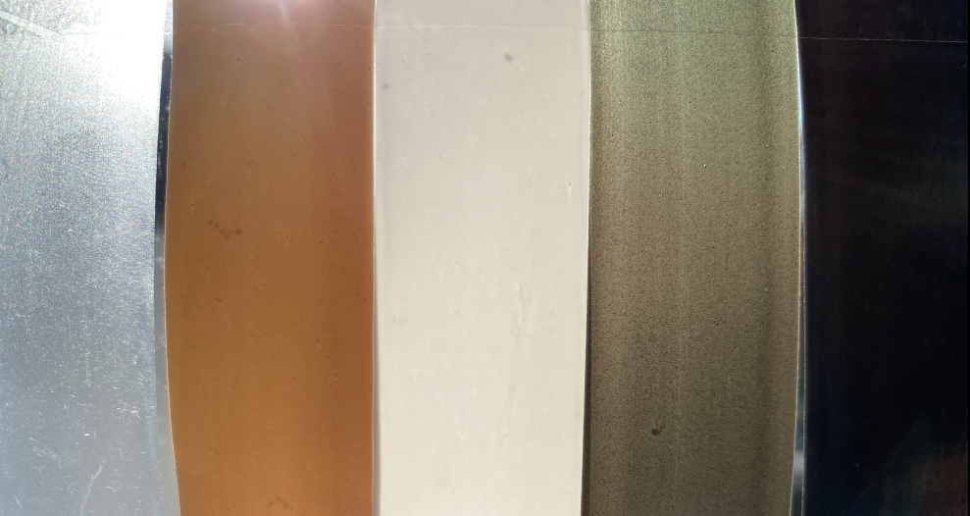
PU-ink systems are better suited for mechanical recycling, but it is not a silver bullet
Optical appearance of extruded film based on printed material
Qualitative overview impact binder
Property | General purpose NC-ink | Heat-stable PU-ink
Gassing during extrusion | Not ok | Ok
Odor recyclate | Not ok | Ok
Gel particles, mechanical properties | Not ok | Not ok – Ok
Discoloration recyclate | Not ok | Not ok
Suitable for food contact (FCM) | No | No
PE reference
Nitrocellulose, white
Polyurethane, white
Nitrocellulose, CMYK
(std. pigments)
Polyurethane, CMYK (HPP)
Source: Recycling of flexible packaging - heat stable inks and deinking I Jul 2023

Slide 29
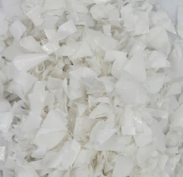
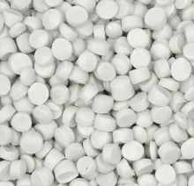
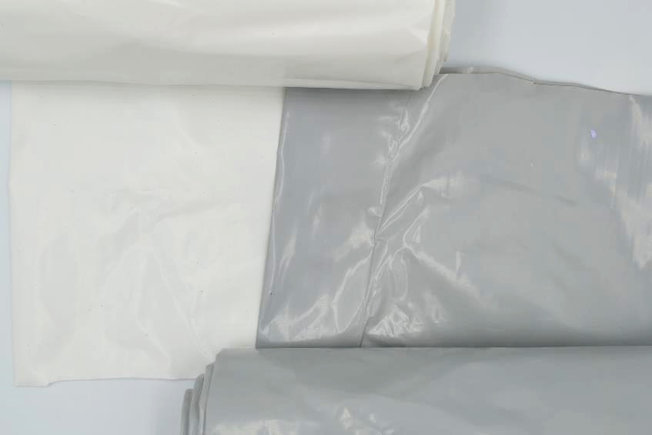
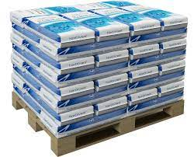

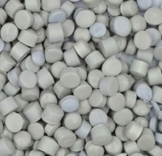
De-inkable solutions allow production of colorless recyclates from printed Post Consumer Waste (PCW)
Basic steps de-inking
De-inkable solutions and chemistry
Material
input
Flaking of
printed film
Washing of
film flakes
Regranulation
of de-inked material
Use of granulate
for new product
With
de-inking
De-inked¹
W/o
de-inking
Not De-inked
1. No additives / masterbatch, 100% recyclate content in films
Source: Recycling of flexible packaging - heat stable inks and deinking I Jul 2023

Slide 30
Making packaging de-inkable
Systematic de-inking studies of all relevant print structures on-going
De-inking resistance
De-inking of any structure possible, but can require too harsh conditions for cost-efficient industrial application (time, temperature, chemicals)
1K SB inks proven to be optimal for de-inking
De-inking primers allow for de-inking of most inks
De-inking primers can delaminate, extending the range of de-inking possibilities
2K coatings
UV- / EB-inks and coatings
With
Primer
2K solvent-based inks
Offset (oil-based)
1K solvent-based inks
Suitability for alkaline hot-wash de-inking
Source: Recycling of flexible packaging - heat stable inks and deinking I Jul 202

Slide 31
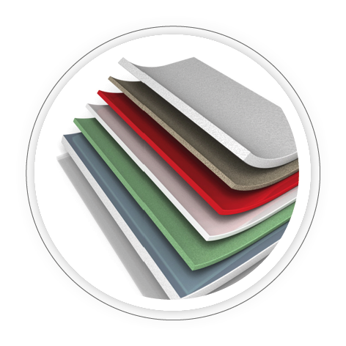
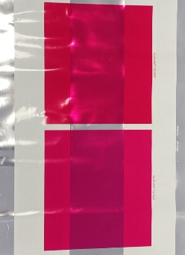
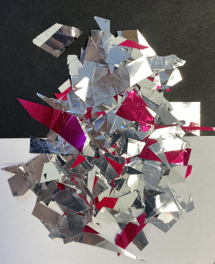
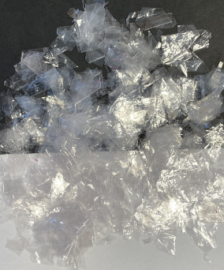
Delamination/de-inking primers ensure smooth de-inking of reverse-printed structures
Option 2
De-inkable structure with Primer
Delamination/de-inking of OPP/met-OPP structure
OPP
Primer
Colour Ink
White Ink
Adhesive
Metallized OPP
Source: Recycling of flexible packaging - heat stable inks and de-inking I Jul 2023
Notes:
The next deinking product is addressing another flexible packaging recycling pain point – which are laminated structures.
As laminated structures are normally reverse-printed, the ink is sandwiched between 2 films and not easily removable from the substrate. Therefore, we have developed a series of alkali strippable primers that facilitate both the opening of the laminate structure and removal of the ink in a hot caustic washing step.
Note that the final performance can depend on the type of adhesive used. In many cases, efficient deinking requires a second breaking point in the structure, due to adhesive initiated cross-linking of the ink. The 2nd breaking point could be a metallization layer, as demonstrated on the schematic, a barrier coating or another layer of the DDP on top of the white. In any case, this is currently not a plug-and-play product and testing is required.
WB-system -> CirKit ClearPrime WB A04 (SAP Code 15-607789-3) -> good performance, but not accepted by converters printing solvent-based systems due to low printing speed and exhaust issues. Previous testing has shown inconsistent BSVs.
SB-system -> CirKit ClearPrime DP 6300 (SAP Code 10-616061-7) -> still undergoing optimization for reaching industrial printing speeds.

Slide 32
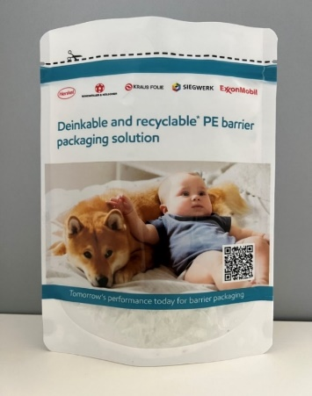
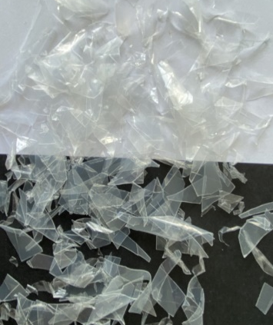
De-inking/de-laminatio can be combined with printed coatings for barrier
Enabled by functional coatings
Stand-up pouch with high barrier
MDO-PE
Primer
Delamination / de-inking primer
Color / White
Printed oxygen barrier
Oxygen barrier coating
Adhesive
PE
Flakes after de-inking
Notes:
For delamination deinking to take place, the primer must be either combined with a WB-adhesive, or a second breaking layer must be introduced, e.g., metallization or as in this case the OBC, that also dissolves under alkaline conditions releasing the ink from the adhesive.

Slide 33
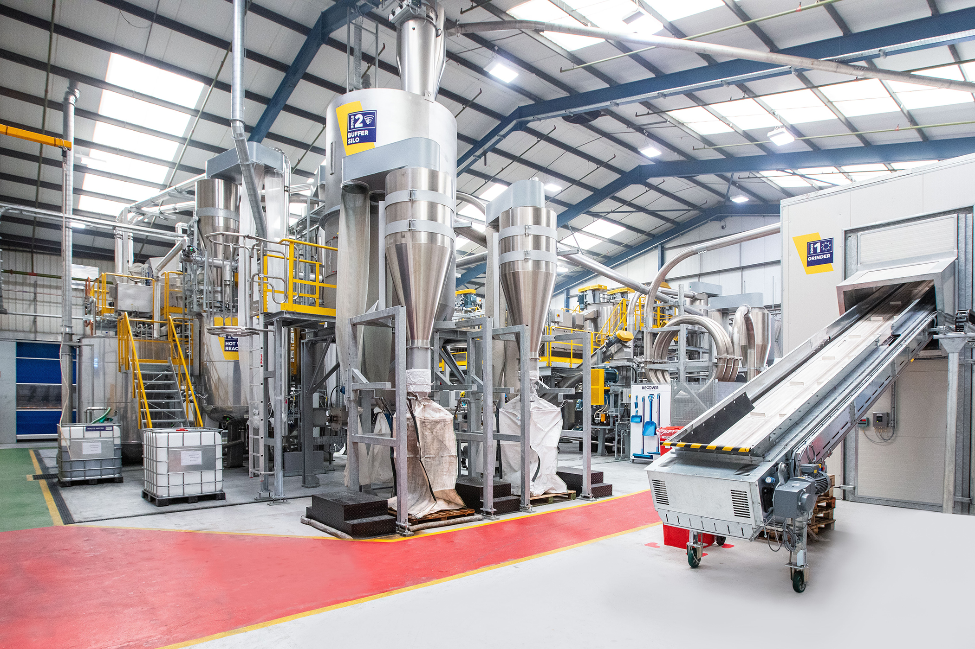
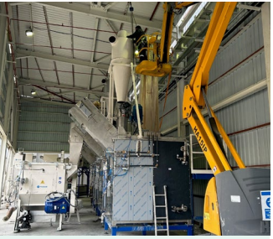
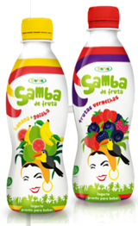
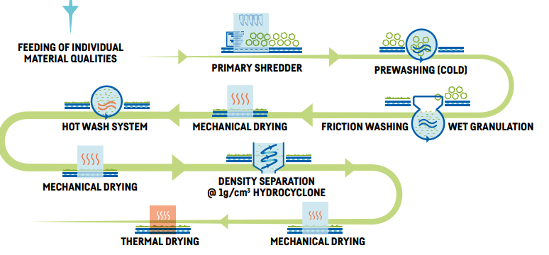
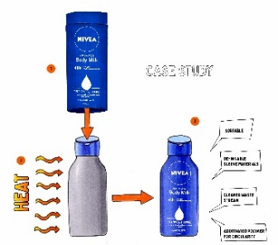
De-inking is emerging in the market, but needs application at scale
Industry initiatives
Packaging converters
De-inkable on market / ready for market⁴
CEFLEX Quality Recycling Process (QRP)¹
Coveris – UK
(PE films)
Huthamaki – Turkey³
ReCover recycling facility²
1: Link to CEFELX: CEFLEX ‘Quality Recycling Process’ - CEFLEX2: Link to Coveris PR: Coveris opens new ReCover recycling facility with pioneering technology | Coveris; 3: Huthamaki Annual Report, 2022, p. 165; 4: Siegwerk

Slide 34
Driving forces of a circular economy

Slide 35
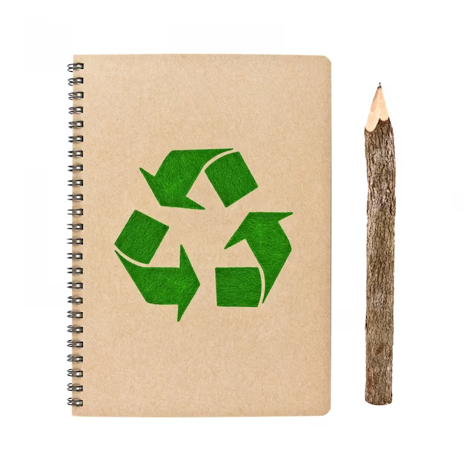




Key Success Factors
Circular Design
Collect, Sort
& Recycle
Produce &
Manufacture
Consume

Slide 36



Circular Design
Circular Design
Increasing (harmonized) design for recycling guidelines
From multi-material to mono-material
Reduce unnecessary packaging
Inks, primers and OPVs have a key role in Circular Design: barrier, heat-stable inks, de-inking etc.
Collect, Sort
& Recycle
Produce &
Manufacture
Consume

Slide 37


Produce & Manufacture
Circular Design
Increase the use of recycled material (food contact suitable)
Replacing fossil raw material with bio-renewable alternatives
Optimize production: reduction
of waste
Investment in transition to monomaterial packaging structures
Collect, Sort
& Recycle
Produce &
Manufacture
Consume

Slide 38


Consume
Circular Design
Consumers are paying more attention to the problem of plastic waste
Do not forget about reusable options
Goal: Consumer acceptance of recycled packaging
Collect, Sort
& Recycle
Produce &
Manufacture
Consume

Slide 39

Collect, Sort & Recycle
Recycling conserves dwindling resources
Extended Producer Responsibility Laws
Recycling needs investments (e.g. de-inking, sorting technologies)
Support: Waste separation at household level
Circular Design
Collect, Sort
& Recycle
Produce &
Manufacture
Consume

Slide 40

Circular Economy and Recycling – a fast moving topic
Activities on regulatory level
Packaging and Packaging Waste Regulation
CEN Working group - Design for recycling for plastic packaging products
Global regulatory trends
Activities on Industry level
CEFLEX
RecyClass
APR
Market movement

Slide 41
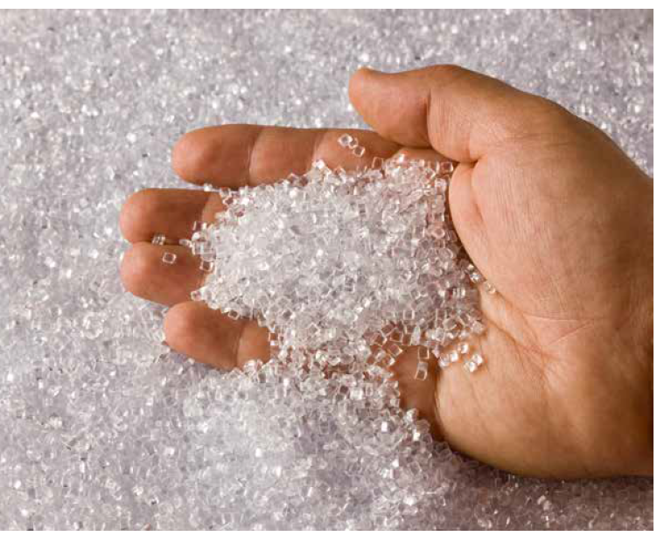
Quo Vadis Circular Economy?
What will tomorrow’s recycling techniques look like (chemical recycling)?
Which packaging structures can be economically recycled?
Do you see different adoption speed of circular packaging globally (e.g. is Europe faster than Asia or North America)? Which region is leading?
How do you see the future pf plastic. Or do you see the trend going towards paper?

Slide 42

Thank you!
Feedback welcome
Q&A

Slide 43

www.WirSindFarbe.de

